Slide 1
ADHD and Sleep:
A Twisted Affair
Roberto Olivardia, Ph.D.
Harvard Medical School
Roberto_olivardia@hms.harvard.edu

Slide 2
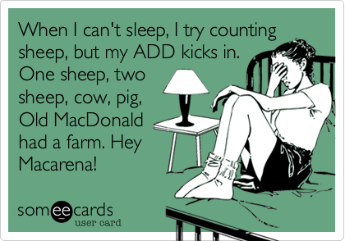

Slide 3
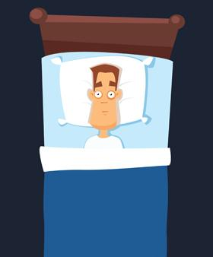
With ADHD, sleep is lying in a boring, dark room waiting for nothing to happen.

Slide 4
How Sleep Issues Affect ADHD
Lower metabolism, Increased appetite. Lead to obesity
Increased hyperactivity
Increased inattentiveness
Moodiness, Irritability
1 hour of sleep loss, 3 nights in a row impacts vigilance on Continuous Performance Test

Slide 5
Common Sleep Issues/Disorders
Difficulty falling asleep (even as an infant)
Unwilling to nap even when exhausted
Feel more alert/energized after dark (10PM)
Go to bed late (2AM)

Slide 6
Common Sleep Issues/Disorders
Difficulty awakening (regardless of ample sleep)
Difficulty in maintaining alertness during day (borderline narcolepsy)
“Primary Disorder of Vigilance”
Restless Leg Syndrome (RLS) (25% of ADHD population)
Symptom severity higher in ADHD than those without ADHD
Sleep talking, sleepwalking, bruxism, bedwetting
Sleep paralysis

Slide 7
Obstructive Sleep Apnea (OSA)
Collapse of upper airway
Associated cessation of airflow at nose and mouth for 10 sec or longer or 30% reduction in flow
1-9% of general population, Males more common
Symptoms: Snoring, Gasping in sleep, choking, restless sleep, sleepiness during day, morning headaches, depression
Effects: Affective lability, impaired short term memory, car accidents, work, academic difficulties, cardiovascular complications, poor focus, inattention, inefficiency at visual motor tasks.

Slide 8
Obstructive Sleep Apnea (OSA)
Anatomical Risk Factors:
* Obese
* Neck size greater than 16/15 inches in men/women
* Nasal polyps
* Deviated septum
* Smaller airway size
* Enlarged uvula
* Enlarged tonsils
OSA and ADHD: Positive response to stimulants

Slide 9
Studies looking at sleep in ADHD populations
Gruber et al (2009) sleep studies in children’s home environment
  15 ADHD children mean 8.45 years old versus 23 normal control 8.58 years old.
  No comorbid disorders.
  Not taking medication and no caffeine more than one week before polysomnography study.
Found ADHD children had:
  decreased REM sleep
  daytime sleepiness
  sleep onset problems
  circadian abnormalities
  less sleep (about 33 minutes)

Slide 10
Studies looking at sleep in ADHD populations
Lam et al (2008) found among Chinese children highly significant and negative association between duration of sleep and ADHD tendency after controlling for confounding variables.
Day et al (1998) found that 60 children divided between ADHD, Other Psych Dx (anxiety disorder, dysthymia, conduct disorder, adjustment disorder), Control. Parents reported more sleep problems with ADHD Group.
Hvolby et al (2009) found that 13% of ADHD kids had frequent nightmares versus 1.4% of controls
Corkum et al (1999) found that 55% of nonclinical comparison group, 86% of unmedicated ADHD group, 96% of medicated ADHD had at least 1 sleep problem

Slide 11
Studies looking at sleep in ADHD populations
Sung et al (2008) found that moderate or severe sleep problems in children with ADHD were strongly associated with the mental health of the primary caregivers, their work attendance, and family functioning.
Sobanski et al (2008): Compared to controls untreated patients showed increased nocturnal activity, reduced sleep efficiency, more nocturnal awakenings and reduced percentage of REM sleep.
Gau et al (2009) found that ADHD adolescents more likely to have current and lifetime sleep problems (insomnia, sleep terrors, nightmares, bruxism, and snoring). The presence of at least 1 psychiatric comorbid condition increased the risks for insomnia and nightmares. Use of methylphenidate was not associated with further increased risk of sleep problems, expect bruxism.

Slide 12
Studies looking at sleep in ADHD populations
Schredl et al (2007) found that ADHD group reported more sleep complaints and not feeling refreshed in the morning more than controls. Insomnia related to presence of comorbidity and depressive symptoms.
Kirov et al (2004) found that ADHD group had shorter REM sleep latency, ADHD children less total sleep time, reduced REM sleep than controls
Cortese et al (2009) meta-analysis: 722 ADHD children and 638 Controls:
ADHD had significantly higher bedtime resistance, more sleep onset difficulties, night awakenings, difficulties with morning awakenings, sleep disordered breathing, and daytime sleepiness compared with controls. Apnea-hypopnea index sig higher in ADHD children than controls. Lower sleep efficiency, true sleep time

Slide 13
Theories: ADHD and Sleep
Biological:
  ADHD involves dopaminergic and serotonin systems.
  Sleep involves serotonin and GABA
  Thus disruption with serotonin systems can disrupt sleep or influence ADHD
Circadian Model: Delayed evening increase in endogenous melatonin levels. (Delayed Sleep Phase Syndrome)
Van der Heijden et al (2005) found that children with ADHD and initial insomnia have a delay in dim light melatonin onset.
Prefrontal cortex: critical role of arousal, sleep, affect, attention> Impairment in one domain and linked to impairment in another

Slide 14
Theories: ADHD and Sleep
Behavioral:
  ADHD symptoms lead to sleep issues
  Prefer night due to less distractions
Genetic Model: Evidence suggesting that catechol-O-methyltransferase (COMT), a gene encoding a dopamine-inactivation enzyme, associated with ADHD, is involved in sleep regulation
Genes associated with arousal and sleep can he inherited

Slide 15
Know Your Sleep Habits
Number of hours of sleep each night
What those hours are
Weekend versus weekday hours
How sleep and where sleep (couch, with TV on etc)
Usual time going to bed and usual time to fall asleep
Awakenings in night, nightmares?
Naps?
How sleep habits affect family others in household?
Ask the spouse, family members
Mood influences

Slide 16
Treatment
Sleep study
CPAP (noncompliance common)
Smits et al (2003) found melatonin to significantly advance sleep onset, reduce sleep latency, and improve health status.
Clonidine
Naps?
Work on getting to bed early 20 minute intervals earlier
Tonsillectomy: rates of inattention and hyperactivity may decrease
Septoplasty
Exercise

Slide 17
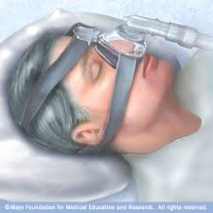
Continuous Positive Airway Pressure (CPAP)

Slide 18
Treatment
Caffeine: Help or hurt?
Introduce stimulating sensory to daytime sleepiness
Relaxation exercises/Deep breathing
Warm bath
UNPLUG
Change in pajamas
Dim lights
Climate control
Sound machines
Light music on repeat
Eye masks/dark rooms
Singing to child, co-sleeping
Get up or not get up?
Assess patient’s motivation to change sleep pattern

Slide 19
Treatment
Studies looking at stimulants and ADHD and sleep
Sobanski et al (2008) found that treatment with methyphenidate resulted in sleep efficiency as well as subjective feeling of improved restorative value of sleep.
Several large double blind pediatric trials comparing extended-release methylphenidate administered once daily, standard release MPH administered 3x a day and placebo reported no sig diff in subjectively rated sleep quality among any treatment arms.
Some studies show difference is whether ADHD is medicated or not
Stein et al (2002) did not find that non-medicated ADHD and controls were different versus medicated ADHD

Slide 20
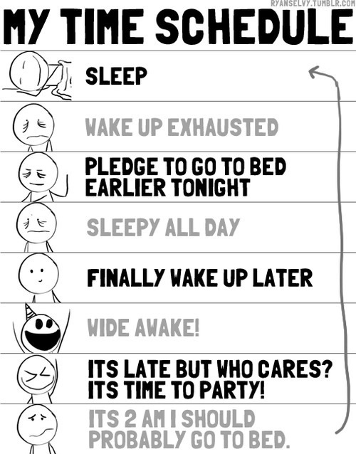

Slide 21
ADHD and Sleep:
A Twisted Affair
Roberto Olivardia, Ph.D.
Harvard Medical School
Roberto_olivardia@hms.harvard.edu

